Slide 1
Following Mirror
Following Mirror
Following Mirror
Embedded Sys & Reconfig Lgc Dsgn
Cheol won Seo, Kyung min Kang, Ju sung Moon

Slide 2
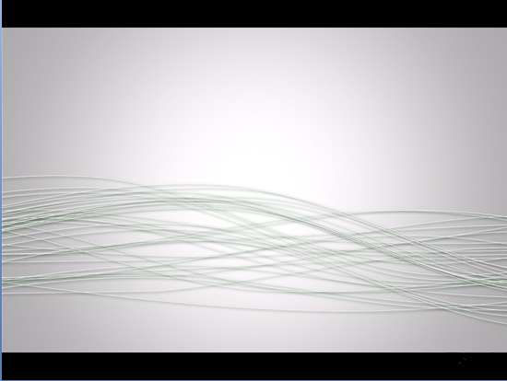
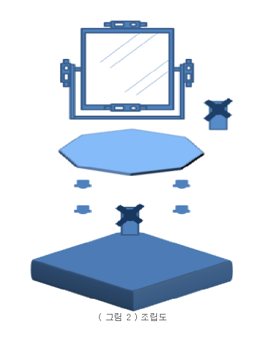
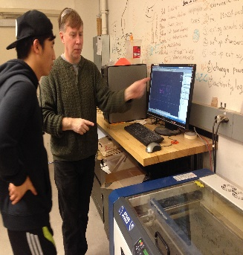


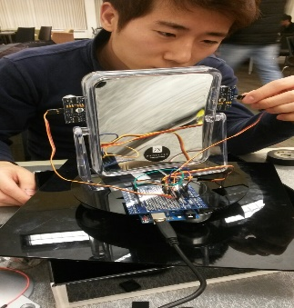
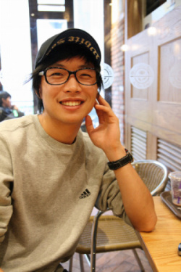

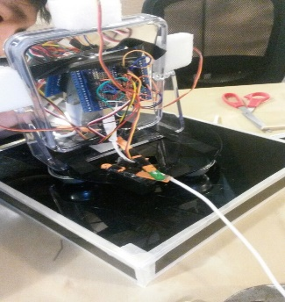
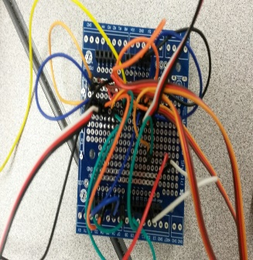


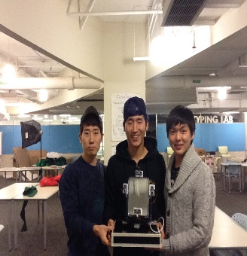
C o n t e n t s
Introduction
How does it work
Architecture Design
Conclusions
5. Q n A

Slide 3
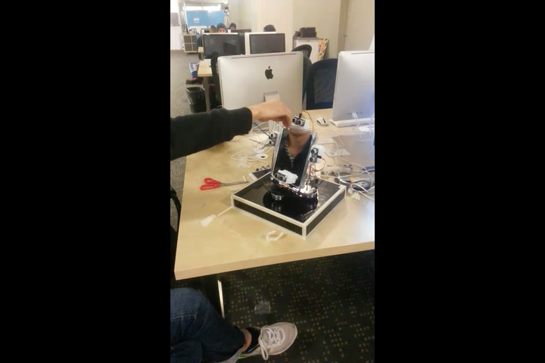
C o n t e n t s
Click video to play demo

Slide 4
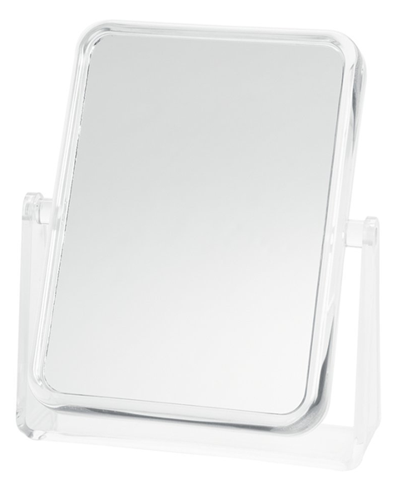
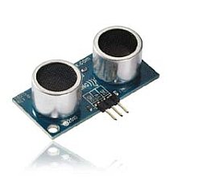
Introduction
Can See
Mirror
Following Mirror
Sensor
Computer Aided Design

Slide 5
Introduction
Following Mirror

Slide 6
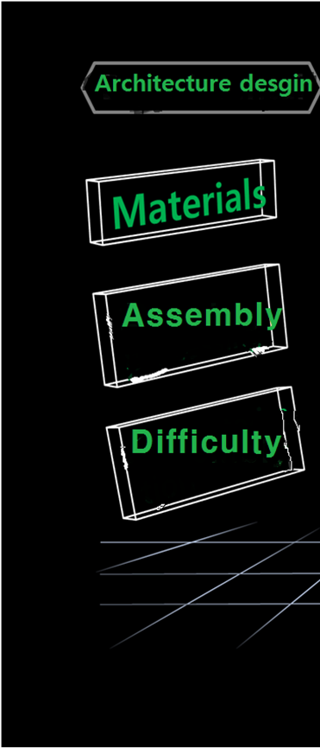
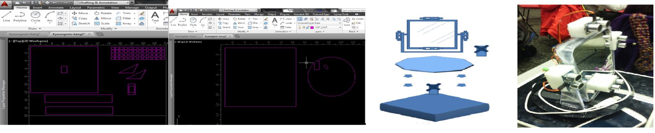
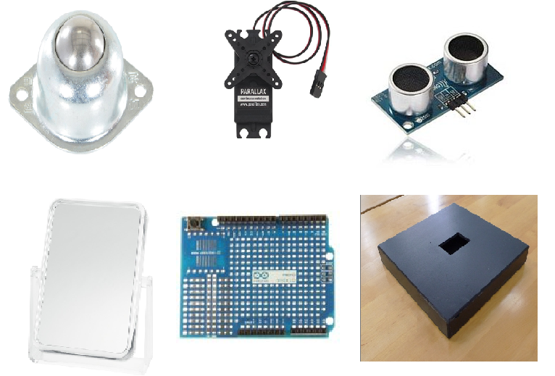
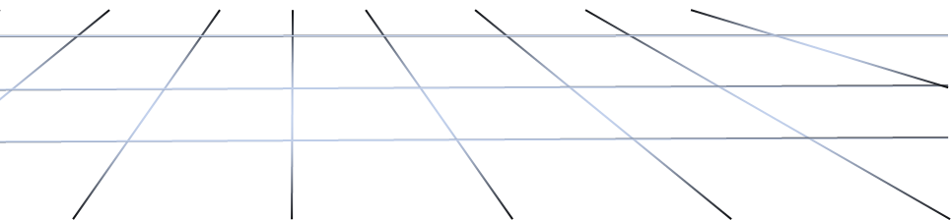
Materials | The number
Rollor Ball | 4
Standard station Servo motor | 2
Parallax Ping Ultransonic Range Sensor | 4
Square Mirror | 1
Arduino Proto Shield | 1
Acrylic Box | 1
Rotary plate | 1
Fig 2. Following Mirror Architecture Desgin
Drawing
Assembly

Slide 7
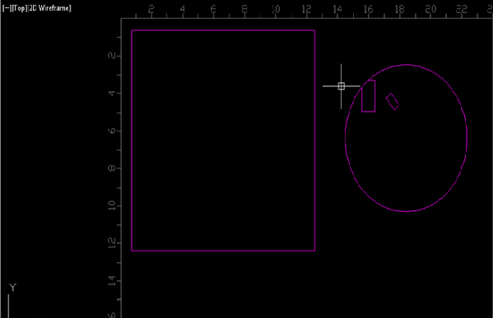
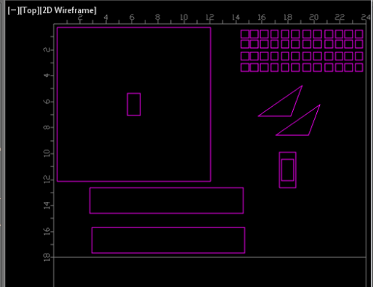
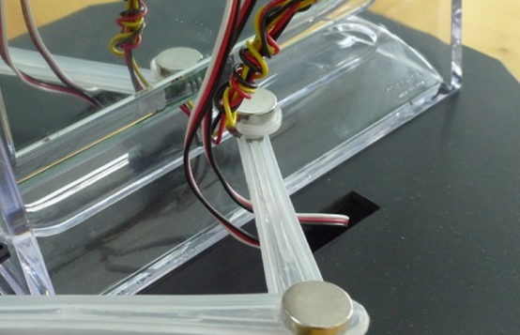
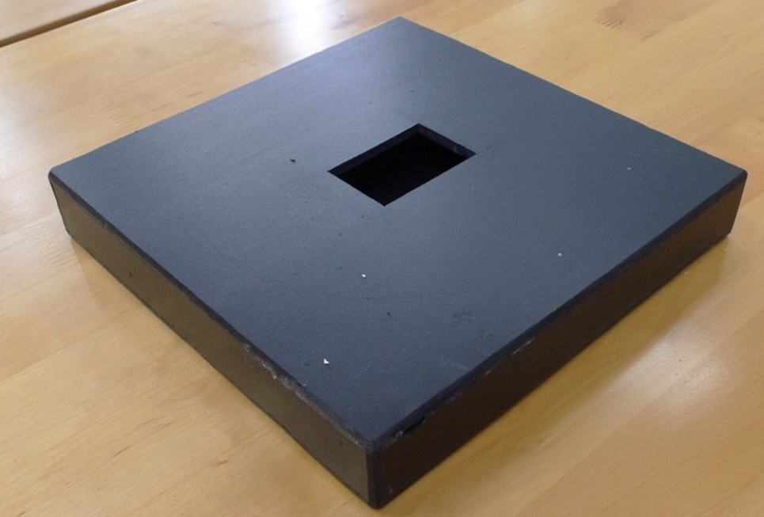
Drawing
Small square
Big square
Big square
Rotary Plate
Box Drawing
Fig 2. You can notice that there are square hole in the Plate and box

Slide 8

Fig 2. Following Mirror Architecture Desgin
.
Drawing
Assembly
Final Assembly

Slide 9
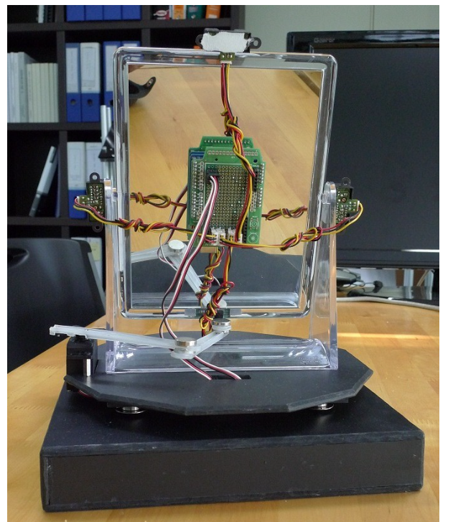
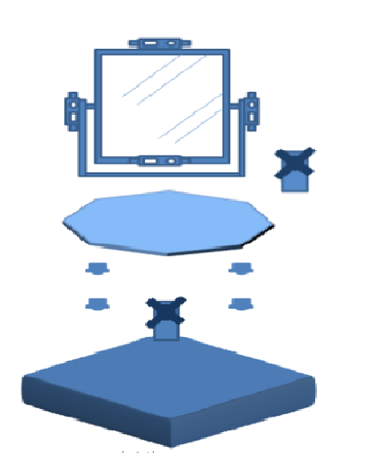
Ultransonic Range Sensor
Assembly Line
Prototype shield arduino
Rollor Ball
Connecting Line

Slide 10
We haven’t gone Idea shop.
We don’t know how to made Drawing
We don’t know how to use the laser print
We have difficulty from attaching the materials

Slide 11
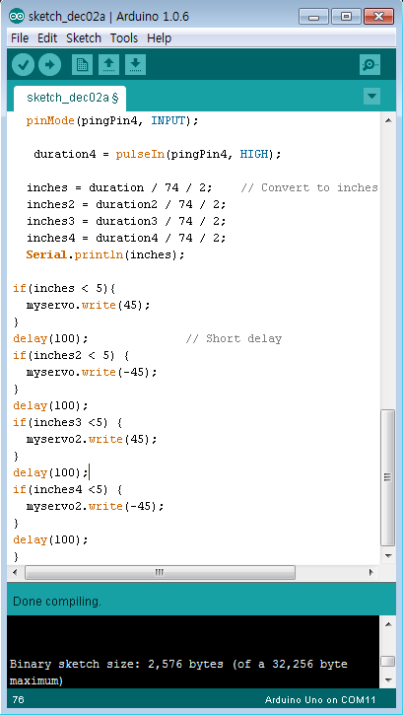
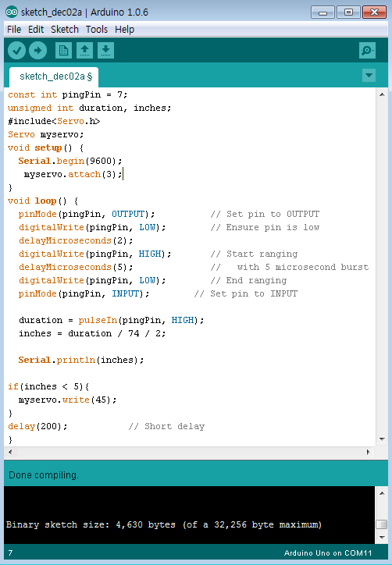

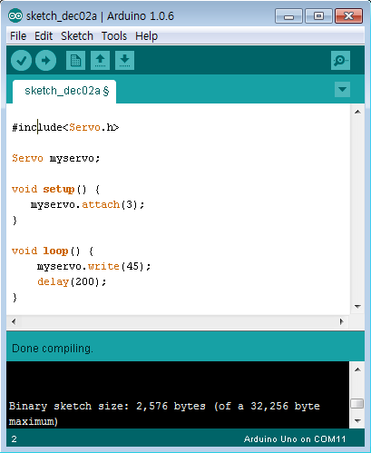
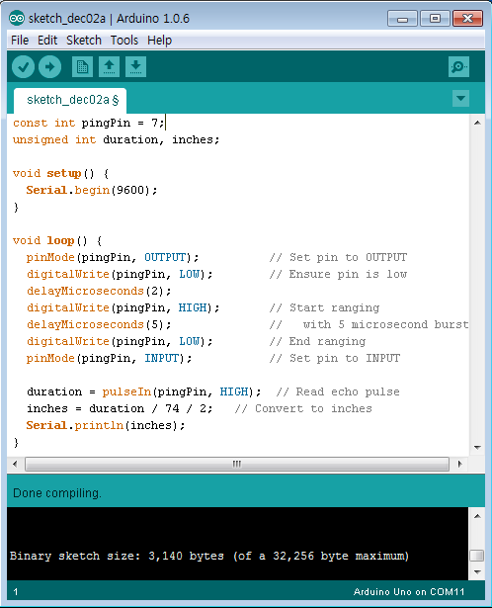
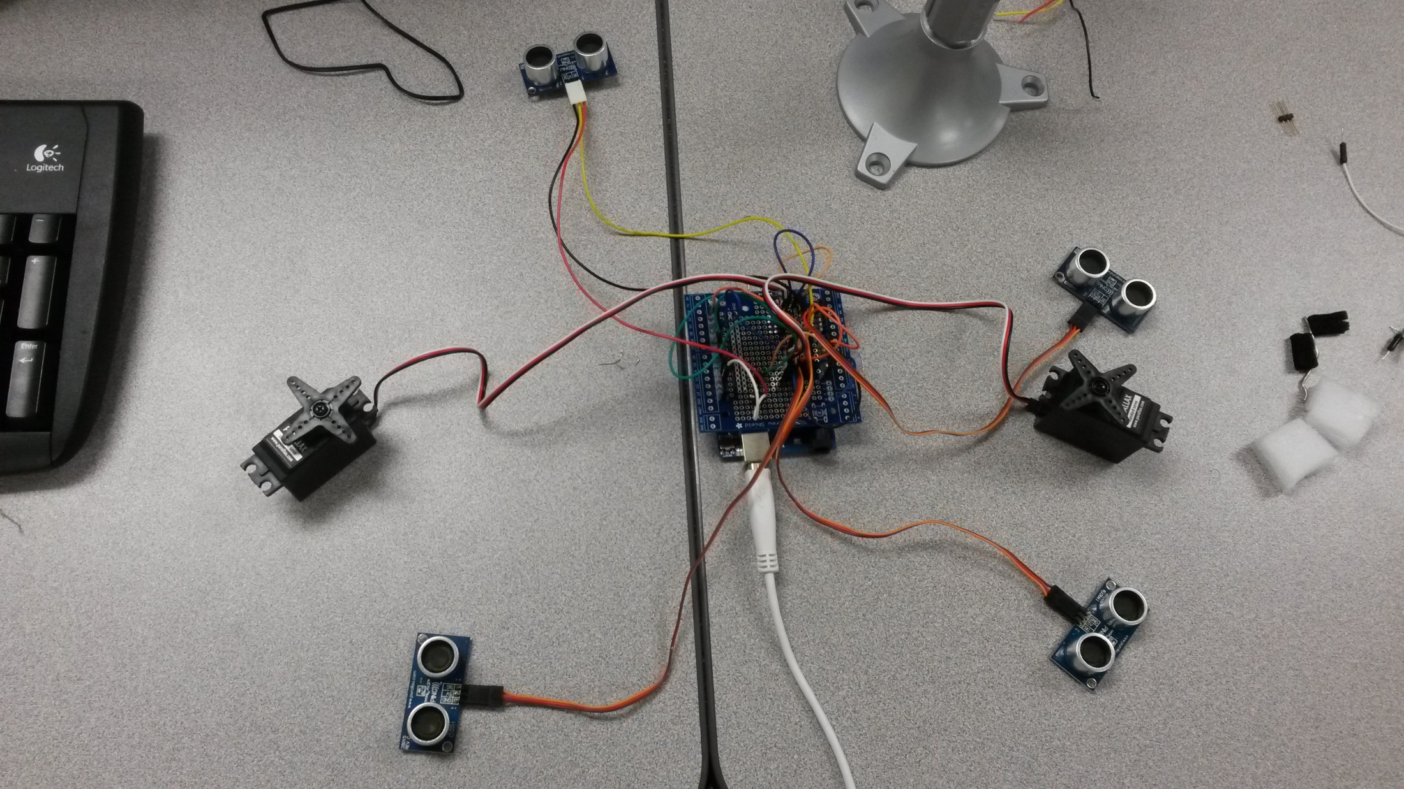
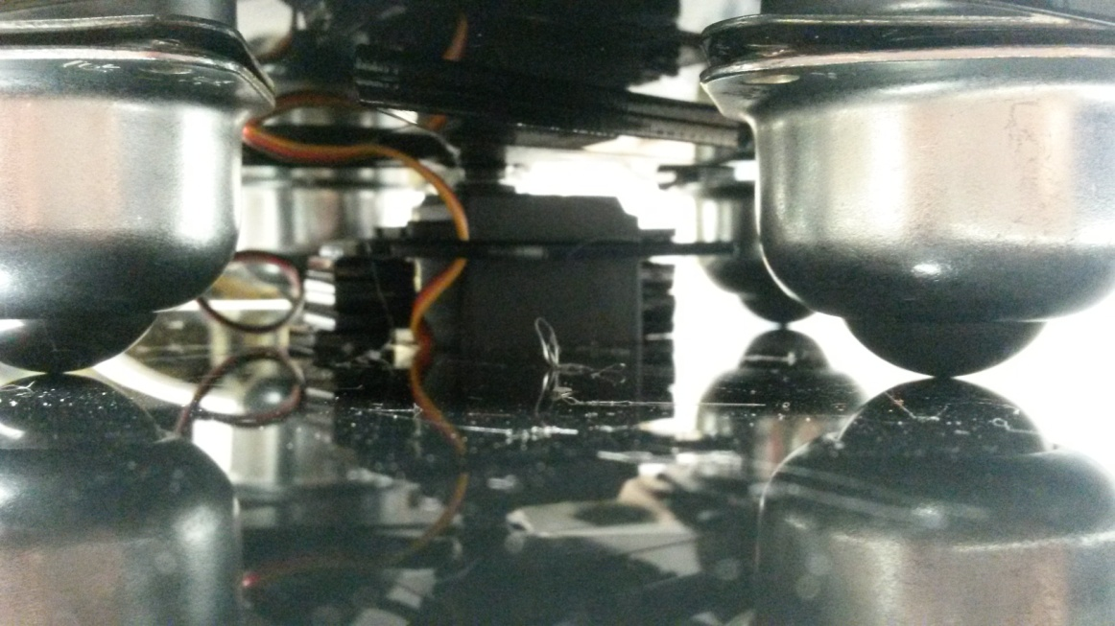
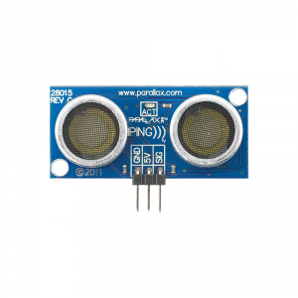
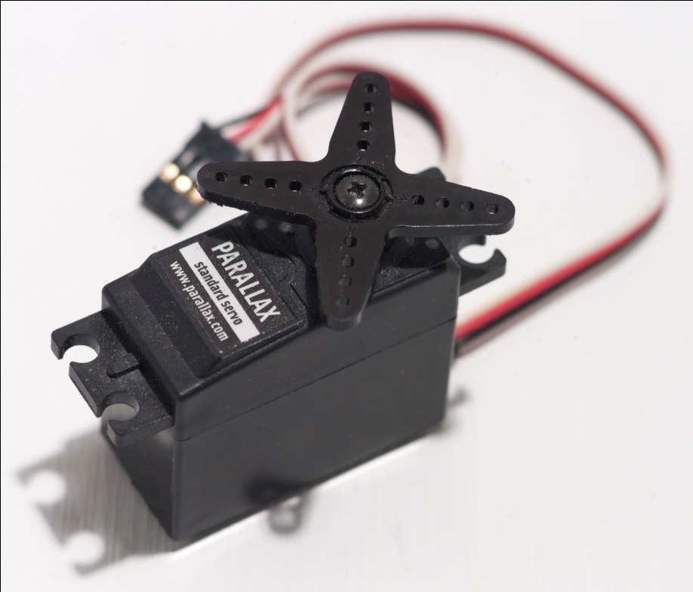
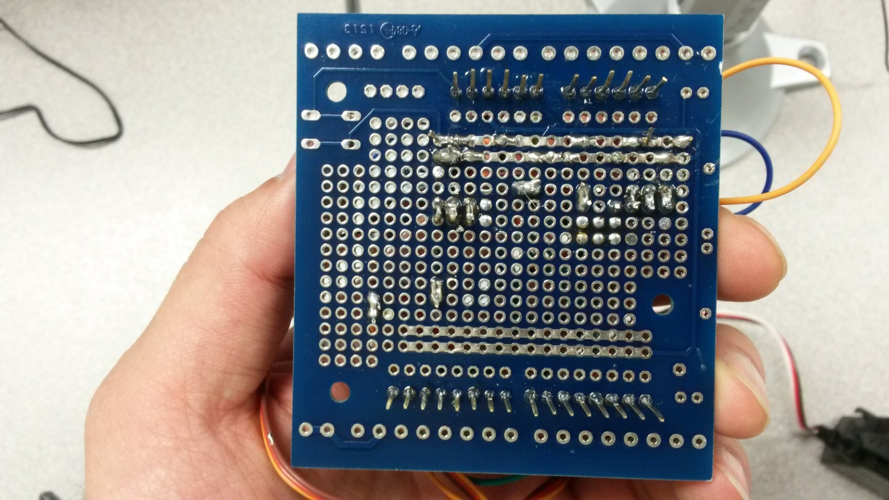
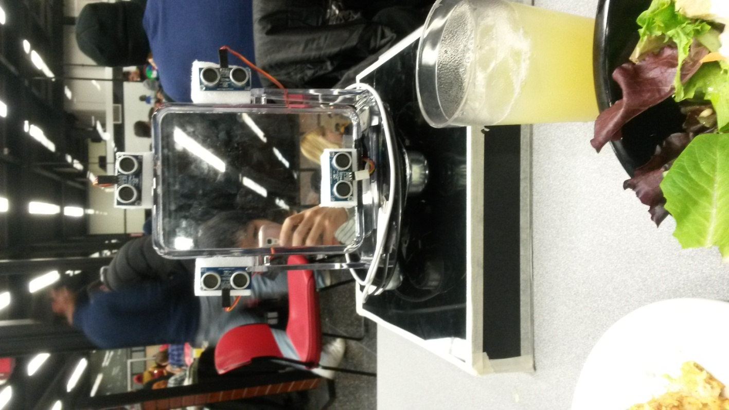
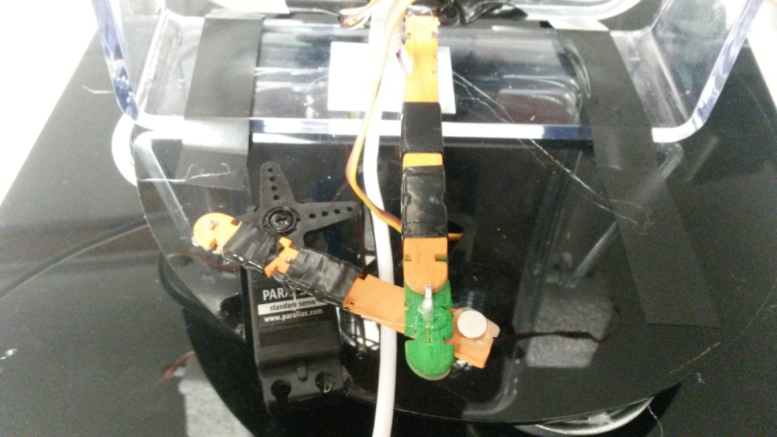
How does it work?
2. Servo motor ( Standard!!)
4. Working principal
3. Proto Shield
5. Code
1. Distance Ultrasonic sensor
This is servo motor which controls left-right movement by attaching under the mirror.
X4
X4
X2
X2
←GND
←5V
Results and discussion
Left
X4
Right
This is the other servo motor which controls up-down movement.
When the servo motor turns clockwise rotation, the stick which attaches mirror pulls lower part of mirror.
When the servo motor turns anticlockwise rotation, the stick pushes lower part of mirror.
Servo motor
Distance sensor
X4
→Signal
Up
X4
Down
Servo motor

Slide 12
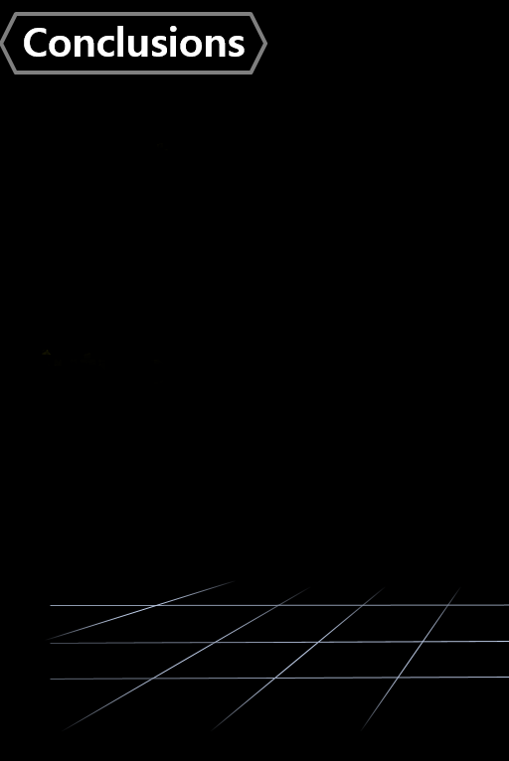

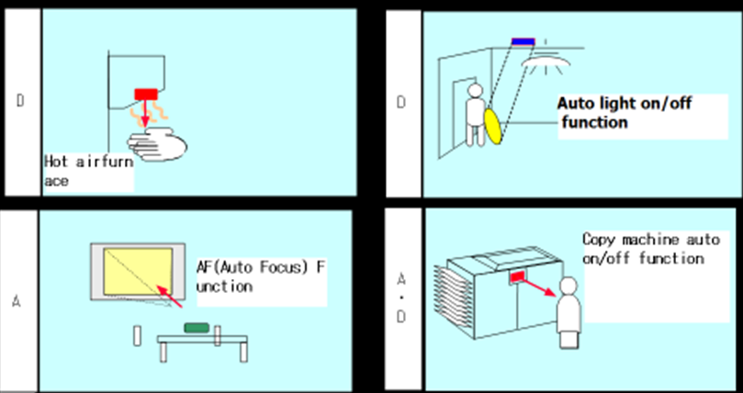
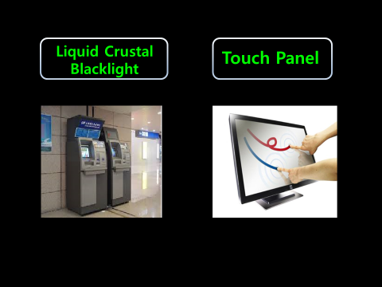
Future
Present

Slide 13

Q n A

Slide 14


